Slide 1
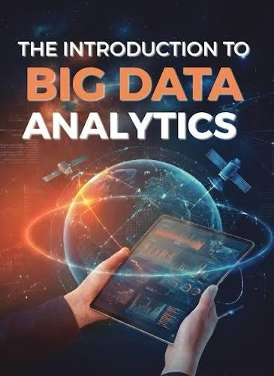
Introduction to Big Data

Slide 2
What is Big Data?
Definition
Big Data refers to extremely large and complex datasets that cannot be efficiently stored, processed, or analyzed using traditional database management systems.
It includes structured, semi-structured, and unstructured data generated from various digital sources.
Examples
Social media posts
Online shopping transactions
Healthcare records
IoT sensor data
Satellite imagery
Financial transactions
Video streaming data

Slide 3
Why Big Data?
Growth of Digital Information
Every day, billions of users generate massive amounts of data through:
Smartphones
Social media
Online banking
GPS devices
Smart watches
IoT devices
Cloud computing
E-commerce websites
Example
A single day of internet activity includes:
Millions of emails sent
Billions of Google searches
Hours of video uploaded to YouTube
Millions of online purchases
Social media interactions
Traditional databases cannot efficiently process this scale of data.

Slide 4
Characteristics of Big Data (5 Vs)
The five fundamental characteristics of Big Data are:
Volume :Volume refers to the enormous amount of data generated
and stored.
Velocity:Velocity is the speed at which data is generated, transmitted, and processed.
Variety :Variety refers to different forms of data.
Veracity :Veracity refers to the quality, reliability, and accuracy of data.
Value: Value refers to extracting useful insights from data.

Slide 5
Classification of Digital Data
Understanding Structured, Semi-Structured, and Unstructured Data

Slide 6
What is Digital Data?
Digital data refers to information represented electronically and stored using binary digits (0s and 1s).
Examples include
Student databases
Hospital records
Emails
Images
Videos
Audio files
GPS coordinates
Social media posts
Sensor readings
Digital Revolution
Today digital data is generated by
Smartphones
Computers
IoT devices
Social media
Banking systems
Hospitals
Industries
Satellites
Every day more than hundreds of quintillions of bytes of data are generated globally.

Slide 7
Classification of Digital Data
Structured :Highly organized
Semi-Structured :Partially organized
Unstructured: No predefined organization

Slide 8

Structured Data
Definition
Structured data is data stored in a predefined format consisting of rows and columns.
It follows a fixed schema.
Characteristics Fixed schema Highly organized Easy searching Easy querying Stored in RDBMS Supports SQL
Example
Student ID | Name | Departm ent | CGPA
101 | John | CSE | 8.7
102 | Riya | ECE | 9.2

Slide 9
Sources of Structured Data
Major sources include
Educational | Hospitals | E-commerce
Institutions Student records Examination databases | Patient records Laboratory reports | Product catalog Customer details Orders
Government Census Passport database Income tax records | Banking Systems ATM transactions Deposits Withdrawals
Database Technologies Structured data is stored in
Oracle
MySQL
SQL Server
PostgreSQL
IBM DB2

Slide 10

Semi-Structured Data
Definition: Semi-structured data does not follow a strict tabular format but contains tags or metadata
Examples
XML
JSON
HTML
Email
Log files
Characteristics of Semi-Structured Data
Flexible schema Self-describing Metadata available Easier integration
Hierarchical structure
Easily exchanged over Internet
Example: no rows , no columns ,still organized
{
"StudentID":101, "Name":"Rahul",
"Department":"CSE",
"CGPA":8.7
}
Example xml: Tags describe the information.
<Student>
<ID>101</ID>
<Name>Rahul</Name>
<Department>CSE</Department>
</Student>

Slide 11
Unstructured Data
Definition: Data without predefined organization or schema. Cannot be stored easily inside relational tables.
Examples
Images
Videos
Audio
News articles
PDFs
CCTV footage
Satellite images
Social media posts
Why Unstructured Data is Important Around 80–90% of enterprise data is unstructured.
It contains valuable information such as
Customer opinions
Human emotions
Medical diagnosis
Security intelligence
Business insights

Slide 12
Challenges with Unstructured Data
Huge Volume
Storage
Searching
Different Formats : Images, Videos, Audio, PDF,Text,Emails
Processing Complexity
Poor Data Quality:Noise,Duplicate files, Corrupted media, Missing metadata
Privacy Issues,Medical images,Personal videos,Voice recordings, Sensitive documents

Slide 13
Handling Unstructured data:
Unstructured data accounts for nearly 80–90% of the world's digital data.
Unlike structured data, it has no predefined schema or table format.
Examples include text documents, emails, images, videos, audio recordings, social media posts, medical images, and satellite imagery.
Processing such data requires a systematic workflow involving data collection, preprocessing, storage, feature extraction, machine learning, and visualization.

Slide 14
Workflow for Handling Unstructured Data
Unstructured Data
(Text, Images, Videos, Audio, PDFs)
│
▼
1. Data Collection
│
▼
Data Cleaning & Preprocessing
│
▼
Data Storage (Data Lake)
│
▼
Feature Extraction
│
▼
Machine Learning / Deep Learning
│
▼
Visualization & Insight Generation
│
▼
Business Decision / Prediction

Slide 15
Step 1: Collect Data
Objective
Gather raw unstructured data from multiple internal and external sources.
Common Sources
Social Media Facebook posts Instagram images X (Twitter) tweets LinkedIn posts | E-commerce Customer reviews Product images Product videos Chat conversations | Enterprise Data Emails PDF reports Word documents Presentations
Healthcare MRI scans CT scans X-rays Electronic Medical Records (EMR) | IoT Devices CCTV cameras Smart sensors GPS devices Wearable devices

Slide 16
Step 2: Data Cleaning & Preprocessing
Raw unstructured data is often incomplete, noisy, duplicated, or inconsistent. Preprocessing improves its quality before analysis.
Objectives
Remove unnecessary information
Improve data quality
Standardize formats
Prepare data for machine learning
Text Data Cleaning Operations include: Remove HTML tags Remove punctuation Convert to lowercase Remove stop words Remove special symbols Spell correction Stemming Lemmatization | Audio Processing Noise reduction Silence removal Speech-to-text conversion Feature extraction
Image Preprocessing Common techniques: Resize images Noise removal Contrast enhancement Image normalization Background removal Data augmentation | Video Processing Frame extraction Video compression Scene segmentation Motion detection Object tracking

Slide 17
Step 3:Store Data in a Data Lake What is a Data Lake?
A Data Lake is a centralized repository that stores raw structured, semi-structured, and unstructured data in its original format until it is needed for analysis.
Unlike a data warehouse, data is stored without requiring a predefined schema (schema-on-read).
Why Use a Data Lake?
Stores massive volumes of data
Supports any file format
Low storage cost
Scalable
Suitable for AI and Big Data analytics
Popular Data Lake Technologies
Hadoop Distributed File System (HDFS)
Amazon S3
Microsoft Azure Data Lake
Google Cloud Storage
Apache Hive
Delta Lake

Slide 18
Step 4: Feature Extraction
Raw data cannot usually be fed directly into machine learning algorithms. It must first be transformed into meaningful numerical representations called features.
Objective
Extract the most informative characteristics from data.
Feature Extraction for Text
Techniques include:
Bag of Words (BoW)
TF-IDF
Word2Vec
GloVe
BERT embeddings

Slide 19
Step 5: Machine Learning & Deep Learning
After feature extraction, machine learning models learn patterns and make
predictions.
Machine Learning Tasks Classification
Examples:
Spam detection
Disease classification
Face recognition
Algorithms:
Decision Tree
Random Forest
SVM
Logistic Regression

Slide 20
Step 6: Generate Insights and Decision Making
The final step converts model outputs into actionable knowledge for
decision-makers.
Visualization Techniques
Dashboards
Charts
Heatmaps
Confusion Matrix
ROC Curve
Interactive Reports

Slide 21
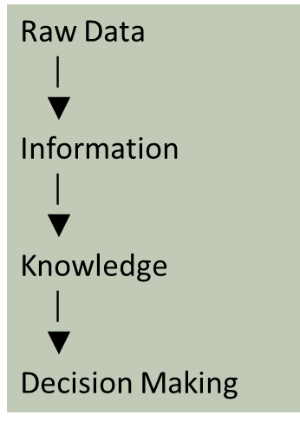
What is Data?
Definition
Data is a collection of raw facts, figures, observations, or measurements that can be processed to generate meaningful information.
Examples
Student marks
Bank transactions
Weather records
Medical reports
Online shopping history
Social media posts
Data → Information → Knowledge
Example:Raw Data
Information
95, 88, 91
Student scored an
average of 91.3%

Slide 22
Characteristics of Data
Good-quality data should possess the following characteristics:
1. Accuracy
Data should be correct and error-free.
Example: Student age should be 21, not 210.
2. Completeness
All required information should be present.
Example: A hospital record should include patient name, age, diagnosis, and
treatment.
3. Consistency
The same data should have the same meaning across different systems.
Example: Customer ID should remain identical in CRM and billing systems.
4.Timeliness
Data should be available when needed.
Example: Live traffic data is more useful than yesterday's traffic report.

Slide 23
Characteristics of Data
Good-quality data should possess the following characteristics:
5. Validity
Data should conform to predefined rules.
Example: Marks must lie between 0 and 100.
6. Reliability
Data should come from trusted and authentic sources.
Example: Government census data is generally more reliable than
anonymous online posts.
7. Relevance
Data should support the intended objective.
Example: Customer purchase history is relevant for product
recommendations.
8. Accessibility
Authorized users should be able to retrieve data easily while maintaining security.

Slide 24
Evolution of Big Data
1960s
Manual Records
│
▼
1970s
File Processing Systems
│
Why Did Big Data Emerge?
As technology evolved, the volume and complexity of data increased dramatically.
Evolution Timeline
▼
1980s
Relational Databases (RDBMS)
│
▼
1990s
Data Warehouses
│
▼
2000s
Big Data (Hadoop)
│
▼
2010s
Cloud Computing & NoSQL
│
▼
Today
AI, Machine Learning, IoT, Edge
Computing

Slide 25
Definition of Big Data Definition
Big Data refers to datasets that are too large, too fast, or too diverse to be efficiently captured, stored, managed, and analyzed using traditional database management systems.
Key Features
Massive size
High generation speed
Multiple formats
Requires distributed storage and parallel processing
Examples
Facebook posts
Google search logs
YouTube videos
Banking transactions
Healthcare records
Satellite imagery
Smart city sensor data

Slide 26
The Three Defining Characteristics (3Vs)
Big Data is primarily characterized by:
Big Data
│
┌───────┼───────--─┐
│ │ │
Volume Velocity Variety
Velocity:
Volume:
Variety:
Speed of data generation and processing.
Amount of data generated.
Different forms and formats of data.

Slide 27
Challenges of Big Data
What are Big Data Challenges?
Big Data challenges are the difficulties faced by organizations while collecting, storing, processing, analyzing, securing, and managing extremely large and complex datasets. Traditional database systems cannot efficiently handle these challenges, requiring distributed computing technologies such as Hadoop, Spark, and cloud computing.
1. Data Storage Challenge Explanation
One of the primary challenges of Big Data is storing massive volumes of information. Modern organizations generate terabytes, petabytes, and even exabytes of data every day. Traditional storage systems are expensive, have limited scalability, and cannot
efficiently manage such enormous datasets.
Why is it a challenge?
Huge storage capacity is required.
Data grows continuously.
Different file formats require flexible storage.
Backup and disaster recovery become difficult.
Solution
Hadoop Distributed File System (HDFS)
Cloud Storage (Amazon S3, Azure Data Lake, Google Cloud Storage)
Distributed File Systems
Example
A hospital stores:
MRI images ,CT scans ,X-ray images ,Laboratory reports ,Patient videos
This can easily require several petabytes of storage.

Slide 28
2. Data Processing Challenge Explanation
After storing data, organizations must process it to extract useful information. Traditional processors take a long time to analyze very large datasets.
Problems
Large computation time
High CPU utilization
Memory limitations
Slow query execution
Example
Solution
Distributed computing frameworks:
Apache Spark
Hadoop MapReduce
Apache Flink
These systems divide tasks among multiple computers and process data in parallel.
Netflix analyzes millions of user interactions every minute to recommend movies. Processing such data on a single computer would take too long.

Slide 29
3. Data Integration Challenge Explanation
Organizations receive data from many different sources, each with different formats and structures.
Data Sources
ERP systems ,CRM systems ,Social media ,Sensors ,Mobile applications ,Databases ,Emails ,Websites
Problem
Combining structured, semi-structured, and unstructured
data into a single analytical platform.
Example
An e-commerce company collects:
Customer profiles (database) ,Product reviews (text)
,Product images ,Videos ,Transaction history
Integrating these different data types is challenging.
Solution
ETL (Extract, Transform, Load)
Apache Kafka
Apache NiFi
Data Lakes

Slide 30
4. Data Quality Challenge
Explanation
Poor-quality data leads to incorrect analysis and poor business decisions.
Common Problems
Duplicate records
Missing values
Incorrect information
Inconsistent formats
Noise
Solution
Data cleaning
Data normalization
Validation
Deduplication
Example : These records refer to the same person but are stored differently.
Rahul Kumar Rahul K.
R. Kumar

Slide 31
5. Security and Privacy Challenge Explanation
Big Data often contains confidential information, making security one of the biggest challenges.
Sensitive Data
Banking information
Medical records
Government records
Biometric data
Risks
Cyber attacks
Data theft
Identity theft
Unauthorized access
Example
Solutions
Encryption
Authentication
Authorization
Firewalls
Multi-Factor Authentication (MFA)
A healthcare database containing patient records must comply with privacy regulations and protect sensitive medical information.

Slide 32
6. Scalability Challenge Explanation
As data volume grows, systems must scale efficiently without affecting performance.
Vertical Scaling
Increasing CPU, RAM, and storage of a single server.
Horizontal Scaling
Adding more servers to the cluster.
Example
Google stores petabytes of search data across thousands of servers rather than
relying on one powerful machine.
Solution
Hadoop Cluster
Cloud Computing
Kubernetes
Distributed Storage

Slide 33
7. Real-Time Processing Challenge Explanation
Many applications require immediate processing and analysis of incoming data.
Examples
Fraud detection
Stock market trading
Smart traffic systems
Online recommendation systems
Emergency healthcare monitoring
Challenge
Data must be processed within milliseconds.
Technologies
Apache Kafka
Apache Spark Streaming
Apache Storm
Apache Flink

Slide 34
8. Data Visualization Challenge Explanation
Billions of records are difficult to understand in raw form. Visualization transforms data into graphs, charts, dashboards, and maps for better interpretation.
Challenges
Large datasets
Dynamic updates
Interactive dashboards
Tools
Tableau
Power BI
Grafana
Apache Superset
Example
An online retailer uses dashboards to monitor sales trends, customer behavior, and inventory levels.

Slide 35
9. Cost Challenge Explanation
Managing Big Data infrastructure requires significant financial
investment.
Expenses
Storage
Servers
Network infrastructure
Software licenses
Cloud services
Skilled professionals
Solution
Cloud computing offers scalable, pay-as-you-go resources, reducing the need for heavy upfront investment.

Slide 36
Other Characteristics of Data Which Are Not Definitional Traits of Big Data
The three defining characteristics of Big Data are Volume, Velocity, and Variety. However, several additional characteristics are equally important because they determine the quality, usefulness, security, and effectiveness of data management.
Defining Characteristics (3Vs) | Supporting Characteristics
Volume | Veracity
Velocity | Value
Variety | Variability
 | Validity
 | Visualization
 | Volatility
 | Vulnerability

Slide 37
Other Characteristics of Data Which Are Not Definitional Traits of Big Data
Veracity: Veracity refers to the accuracy, reliability, and trustworthiness of data.
Value: Value refers to the usefulness and business benefit obtained from analyzing data.
Variability: Variability refers to the changing meaning, structure, or flow of data over time.
Validity:Validity ensures that data conforms to predefined rules and business constraints.
Visualization: Visualization is the graphical representation of data to simplify understanding and communication.
Volatility: Volatility refers to the lifespan of data or how long it remains useful before becoming outdated.
Vulnerability: Vulnerability refers to the susceptibility of data to security threats such as cyberattacks, unauthorized access, and data breaches.

Slide 38
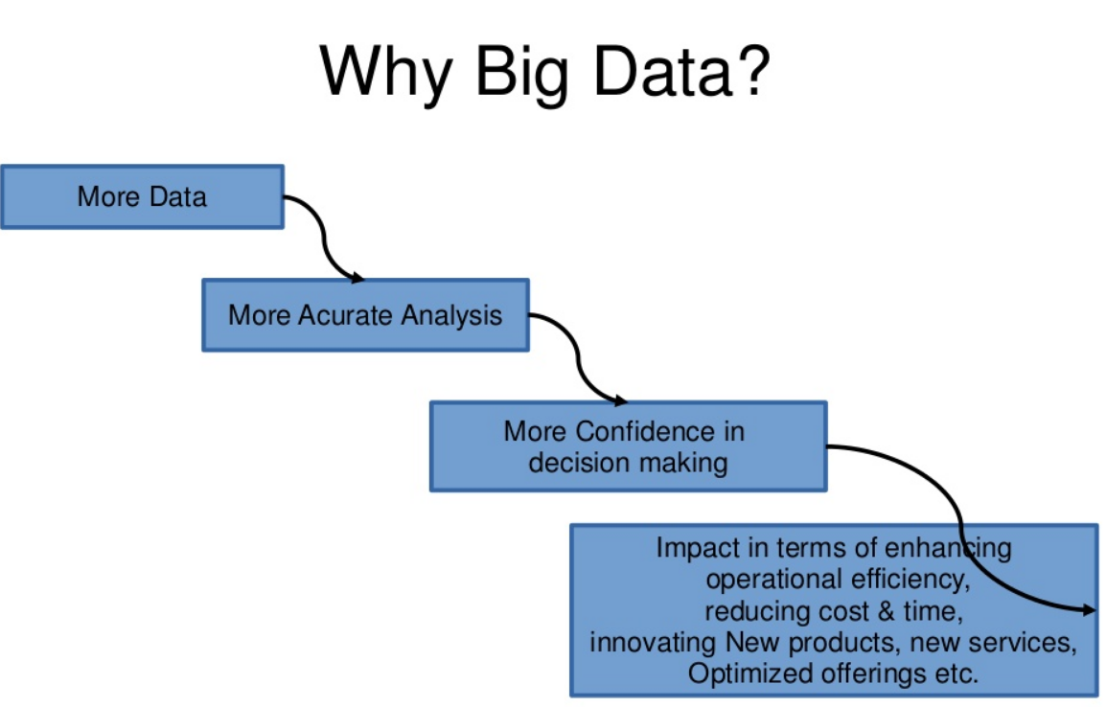

Slide 39
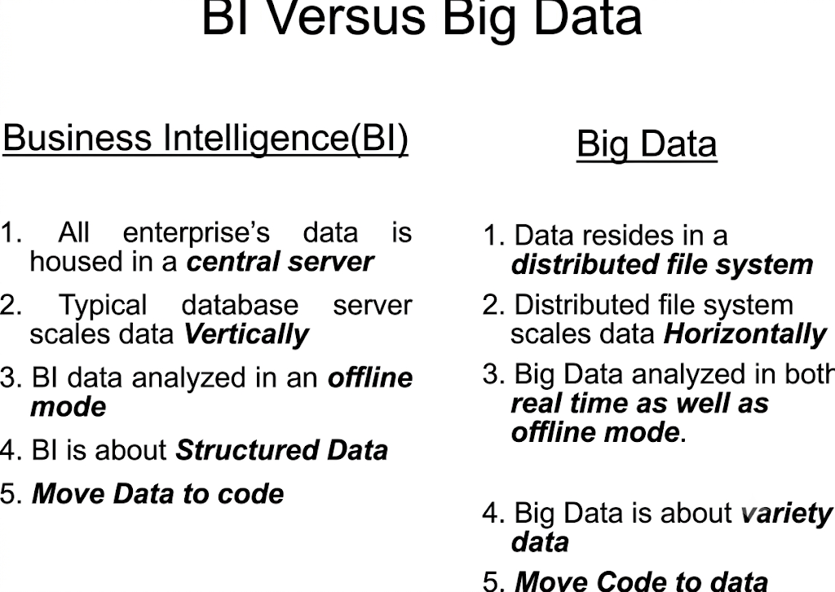

Slide 40
Business Intelligence vs Big Data
Big Data and Business Intelligence are two technologies used to analyze data to help companies in the decision-making process, there are differences between both of them.
They differ in the way they work as much as in the type of data they analyze.
Traditional BI methodology is based on the principle of grouping all business data into a central server.
Typically, this data is analyzed in offline mode, after storing the information in an environment called Data Warehouse. The data is structured in a conventional relational database with an additional set of indexes and forms of access to the tables (multidimensional cubes).
A Big Data solution differs in many aspects to BI to use. These are the main differences between

Slide 41
Big Data and Business Intelligence:
In a Big Data environment, information is stored on a distributed file system, rather than on a central server. It is a much safer and more flexible space.
2. Big Data solutions carry the processing functions to the data, rather than the data to the functions. As the analysis is centered on the information, it´s easier to handle larger amounts of information in a more agile way.
3. Big Data can analyze data in different formats, both structured and unstructured. The volume of unstructured data (those not stored in a traditional database) is growing at levels much higher than the structured data. Nevertheless, its analysis carries different challenges. Big Data solutions solve them by allowing a global analysis of various sources of information.
4. Data processed by Big Data solutions can be historical or come from real-time sources. Thus, companies can make decisions that affect their business in an agile and efficient way.
5. Big Data technology uses parallel mass processing (MPP) concepts, which improves the speed of analysis. With MPP many instructions are executed simultaneously, and since the various jobs are divided into several parallel execution parts, at the end the overall results are reunited and presented. This allows you to analyze large volumes of information quickly.

Slide 42
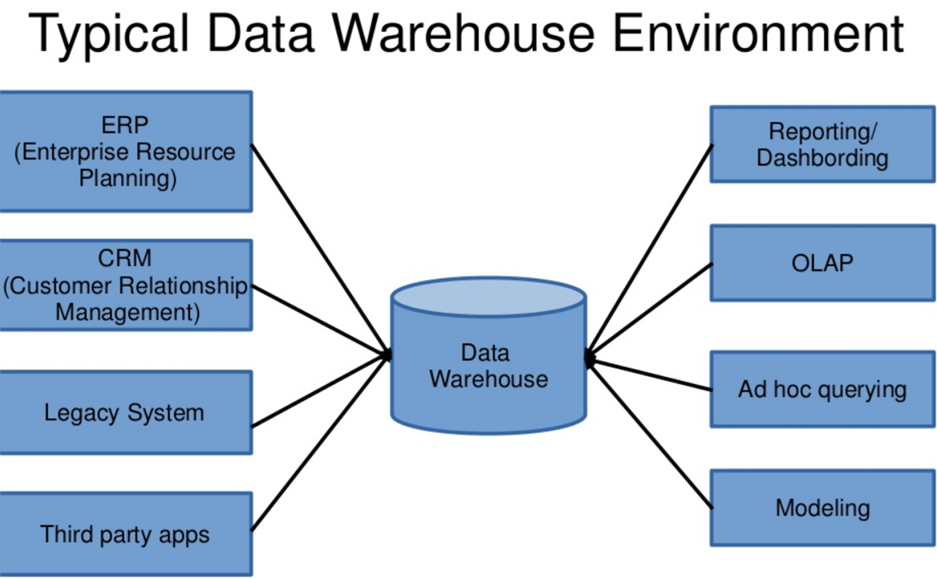

Slide 43
Architecture of a Data Warehouse
Operational Systems
(ERP, CRM, Banking, HR)
│
▼
ETL (Extract, Transform, Load)
│
▼
Data Warehouse
│
┌───────┐
▼ ▼
Data Mart OLAP Cubes
│
▼
Reports & Dashboards
│
▼
Business Intelligence
1. Data Sources Examples:ERP ,CRM ,Banking systems ,Hospital databases Payroll systems | 3. Data Warehouse Stores structured historical data optimized for analytical queries. Examples:Oracle ,SQL Server ,Teradata Snowflake
2.ETL Process Extract,Collect data from multiple sources. ↓ Transform,Clean, validate, standardize, integrate. ↓ Load Store into Data Warehouse. | 4. Data Mart A subset of the Data Warehouse designed for a specific department. Examples Sales Data Mart Finance Data Mart HR Data Mart
5. OLAP (Online Analytical Processing) Supports multidimensional analysis. Operations include Drill-down ,Roll-up ,Slice ,Dice,Pivot | 6. BI Tools Examples Power BI Tableau SAP BusinessObjects IBM Cognos

Slide 44
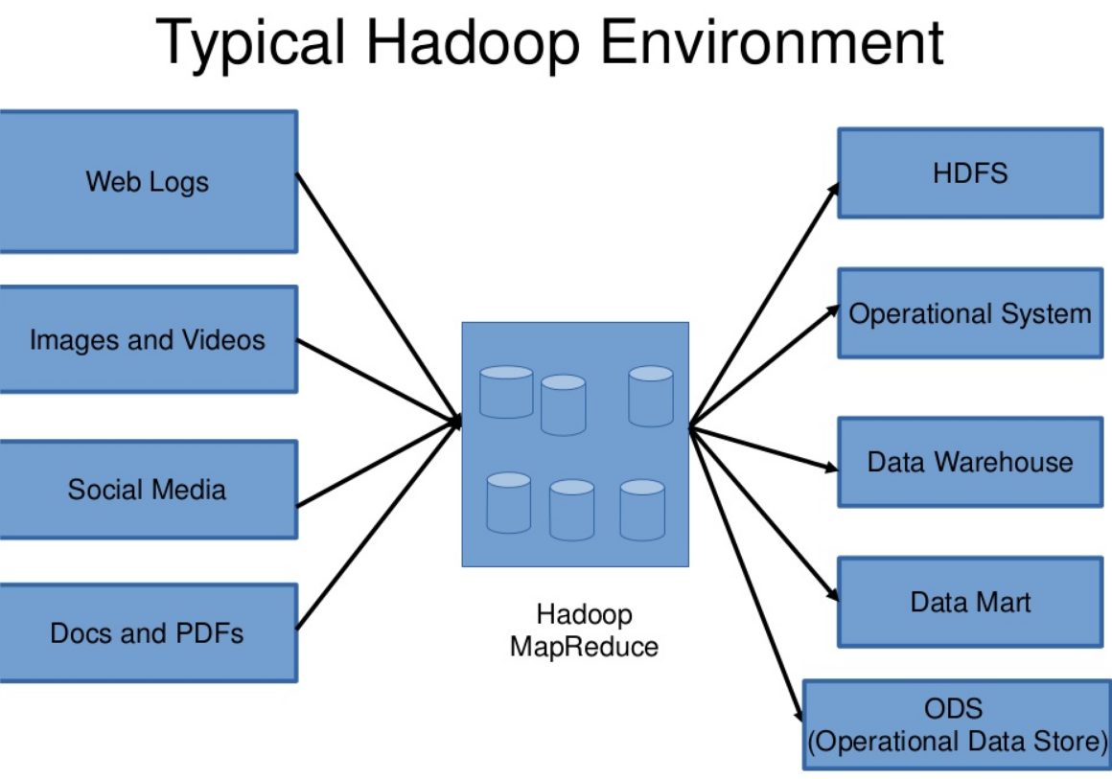

Slide 45
Data Sources
Social Media | IoT | Logs | Databases
Images | Videos | Sensors | Emails
│
▼
Data Ingestion Layer
Sqoop | Flume | Kafka | APIs
│
▼
Hadoop Distributed File System (HDFS)
│
▼
YARN (Resource Manager)
│
┌────┴────┐
▼ ▼
MapReduce Apache Spark
│
▼
Hive | Pig | HBase | Impala
│
▼
Machine Learning & Analytics
│
▼
Dashboards & Visualization
A Typical Hadoop Environment
What is Hadoop?
Apache Hadoop is an open-source distributed framework that stores and processes massive datasets across clusters of commodity hardware.
It is designed to manage:
Structured data
Semi-structured data
Unstructured data

Slide 46
Hadoop Components
HDFS Stores files across multiple computers. Advantages Fault tolerance Scalability High availability | MapReduce Programming model for distributed processing. Two stages Map ↓ Reduce
YARN Resource management framework. Functions: Allocates CPU Allocates Memory Schedules jobs | Hive SQL interface for Hadoop. Allows SQL-like queries.
HBase NoSQL database built on Hadoop. Supports random read/write operations. | Spark Fast in-memory processing engine. Up to 100× faster than traditional MapReduce for many workloads.

Slide 47
Component | Main Function
Social Media | Generates user/content data
IoT | Generates device data
Logs | Records system activities
Databases | Stores structured enterprise data
Images/Videos | Multimedia data
Sensors | Continuous measurements
Emails | Communication data
Kafka | Event/data streaming
Flume | Log ingestion
Sqoop | RDBMS ↔ Hadoop bulk transfer
APIs | Application-to-application data access
HDFS | Distributed storage
YARN | Resource management
MapReduce | Distributed batch processing
Spark | Fast distributed processing
Hive | SQL-based analytics
Pig | Data-flow scripting
HBase | NoSQL storage/database
Impala | Interactive SQL analytics
ML/Analytics | Finds patterns and predictions
Dashboards | Displays results

Slide 48
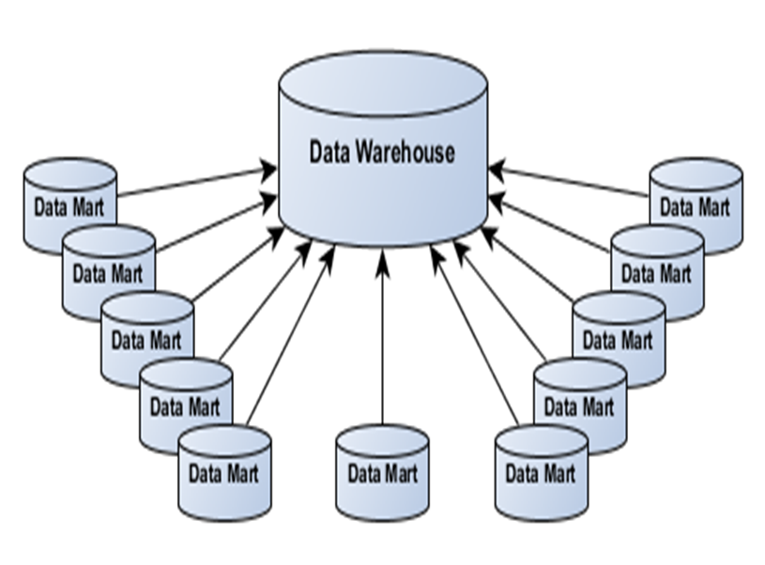
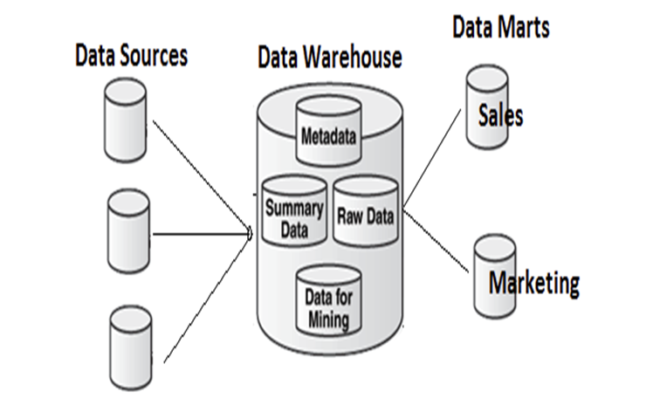
Data Mart
Generally, a data mart can be thought of as a subset of a data warehouse. The data mart is a storehouse of data that is meant to serve a specific community and is designed to meet the needs of a specific group of users.
Data marts are usually controlled by a single department of an organization like sales, finance, etc.

Slide 49
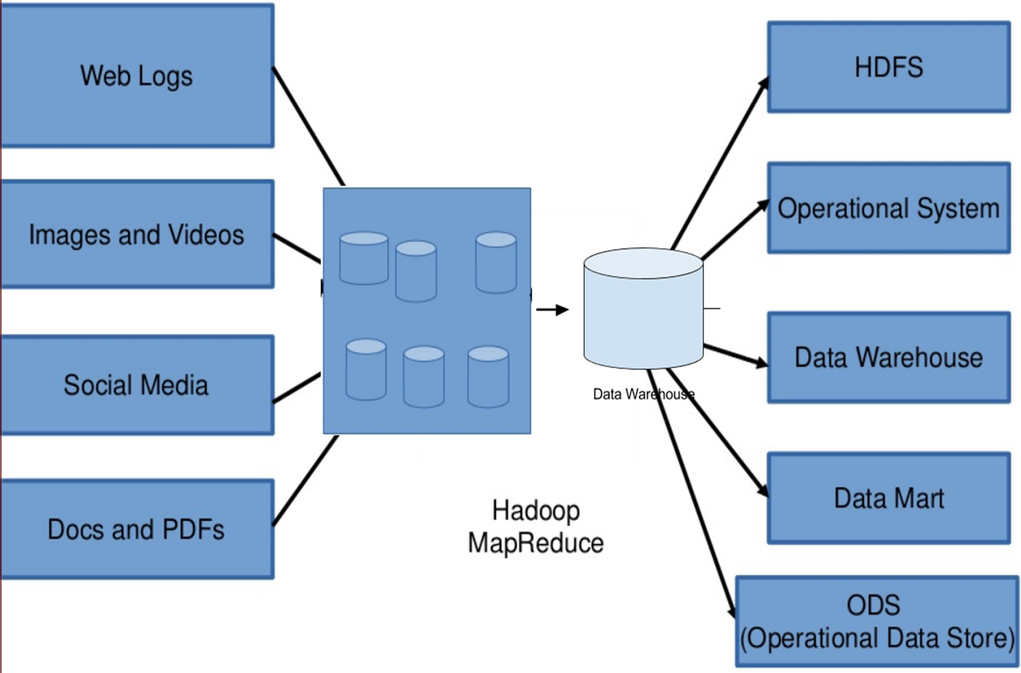
Big Data and Data Warehouse Coexistence

Slide 50
Coexistence of Big Data and Data Warehouse
Why Both Are Needed?
Organizations still need Data Warehouses for structured reporting while using Big Data platforms for advanced analytics.
Instead of replacing each other, they complement one another.
Enterprise Systems
ERP | CRM | Banking | HR | Sales
│ │
▼ ▼
Data Warehouse Hadoop Data Lake
│ │
│ │
Historical Reports Machine Learning
Business Dashboards Real-Time Analytics
│ │
└──────┬───────┘
▼
Executive Decision Making
Example
Bank Data Warehouse
Customer accounts
Loan history
Monthly reports
Hadoop
ATM logs
CCTV videos
Customer complaints
Fraud detection
Social media analysis
Together they provide complete business intelligence.

Slide 51
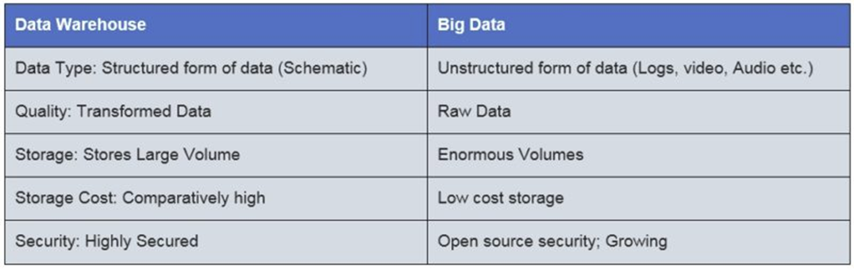
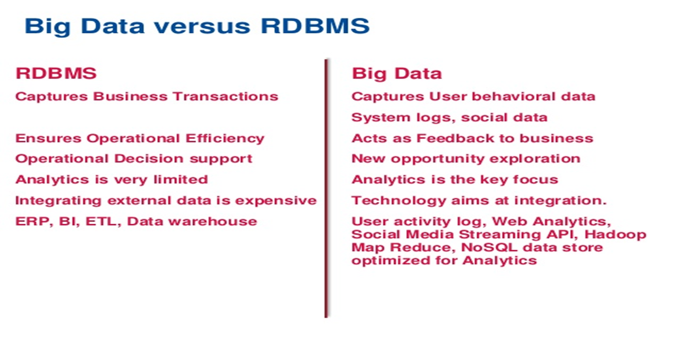

Slide 52
Comparison
Structured: Easy Semi: Moderate
Unstructured: Complex

Slide 53
Case Study
Amazon: orders, JSON APIs, reviews/images.

